Slide 1


Green Pace
Security Policy Presentation
Developer: Alexis Indick

Slide 2

OVERVIEW: DEFENSE IN DEPTH
This model represents the many layers of defense in depth (DiD) that must be performed in order for a properly protected system.

Slide 3
THREATS MATRIX
This matrix is representative of the many types of threats that can happen.
This chart also shows the priority this is taken for each.
Likely Threats that are very likely to happen. | Priority Vulnerabilities that need to be fixed immediately.
Low priority Vulnerabilities that are not as important to fix immediately. | Unlikely Threats that are most likely not to happen.

Slide 4
10 PRINCIPLES
Validate Input Data (STD-001-CPP, STD-002-CPP, STD-003-CPP, STD-004-C)
Heed Compiler Warnings (STD-005-CPP, STD-006-C, STD-007-CPP, STD-008-CPP STD-009-CPP)
Architect and Design for Security Policies (STD-008-CPP, STD-010-CPP)
Keep It Simple (STD-007-CPP, STD-009-CPP, STD-010-CPP)
Default Deny
Adhere to the Principle of Least Privilege (STD-004-C)
Sanitize Data Sent to Other Systems
Practice Defense in Depth
Use Effective Quality Assurance Techniques (STD-004-C, STD-006-C, STD-008-CPP)
Adopt a Secure Coding Standard (STD-003-CPP, STD-004-C, STD-005-CPP, STD-009-CPP, STD-010-CPP)

Slide 5
CODING STANDARDS
Do not cast to an out-of-range enumeration value
Use valid references, pointers, and iterators to reference elements of a container
Do not attempt to create a std::string from a null pointer
Exclude user input from format strings
Do not access freed memory
Incorporate diagnostic tests using assertions
Handle all exceptions
A signal handler must be a plain old function
Avoid deadlock by locking in a predefined order
Write constructor member initializers in the canonical order

Slide 6
ENCRYPTION POLICIES
Types of Encryption:
At Rest
In Flight
In Use

Slide 7
TRIPLE-A POLICIES
The Triple-A Security Policies:
Authentication
Authorization
Accounting

Slide 8
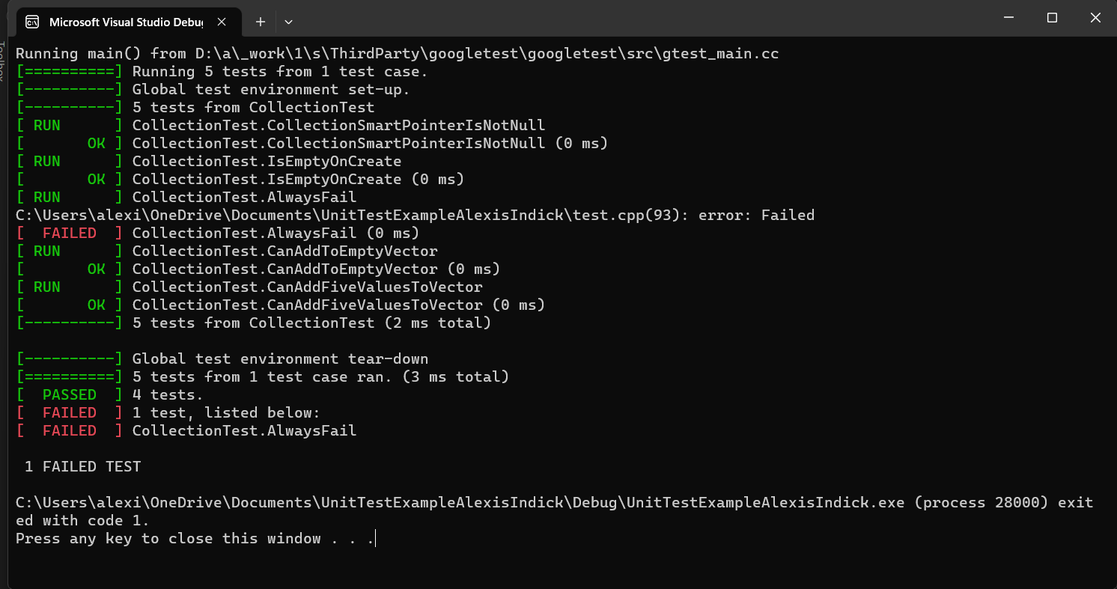
Unit Testing
Before Unit Testing Cases --->
Here we have an image of
the program before I started
writing cases for each unit test.
There we a lot of problems that
needed corrections.
Ex. Verifying adding a
single value to the collection.

Slide 9
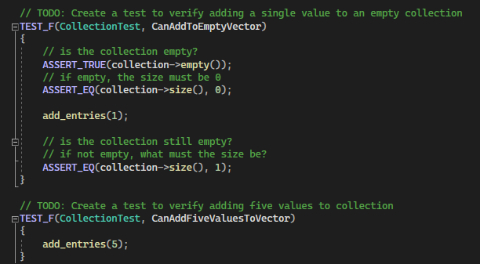
Test Case 1: Adding Single Values to a Collection and More than 1 Value

Slide 10
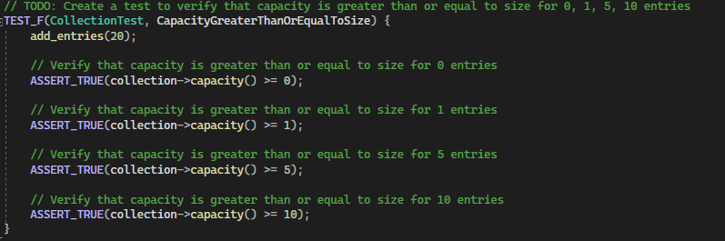
Test Case 2: Verifying Capacity

Slide 11
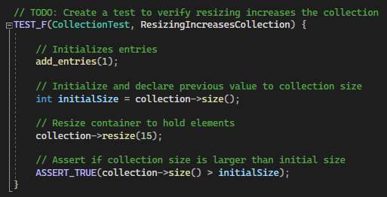
Test Case 3: Testing Resizing with Increase

Slide 12
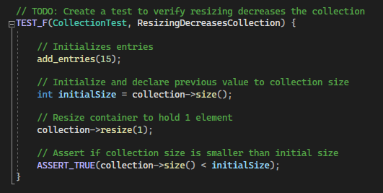
Test Case 4: Testing Resizing with Decrease

Slide 13
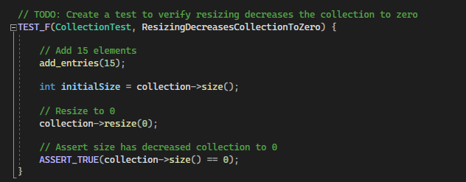
Test Case 5: Testing Decreasing to Zero

Slide 14
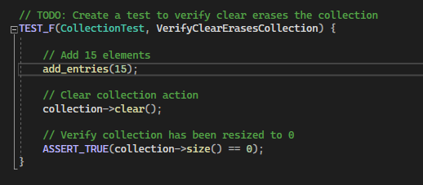
Test Case 6: Testing Erasing with Clear

Slide 15
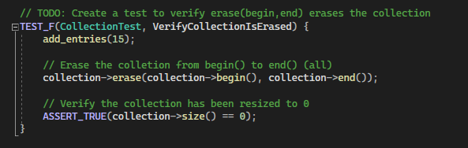
Test Case 7: Testing Erasing at the Beginning to End

Slide 16
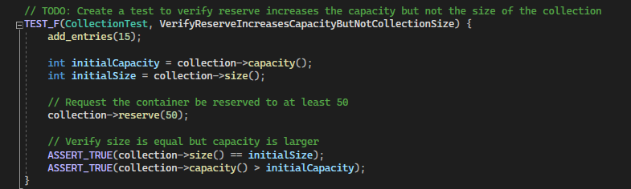
Test Case 8: Verifying Reserve Increase but Not Size

Slide 17
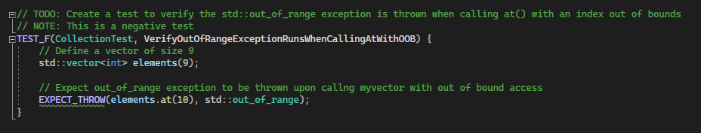
Test 9: Verifying Out of Range Exception

Slide 18
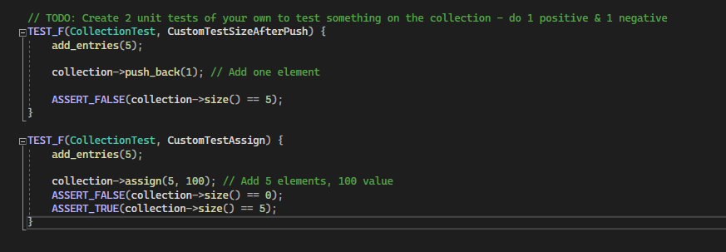
Test Case 10: 2 Tests for Checking a Positive and Negative

Slide 19
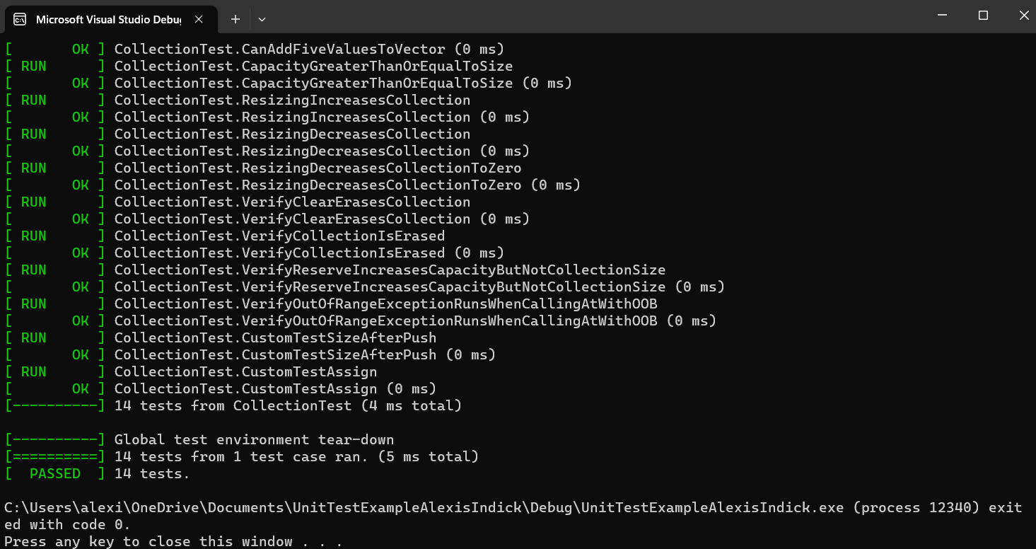
Unit Testing (cont.)
After Unit Testing Cases --->
All tests were correct and
passed!

Slide 20

AUTOMATION SUMMARY

Slide 21
TOOLS
Automation should be incorporated throughout the DevSecOps cycle. The pipeline shows the use of DiD methods which are important in keeping application secure.
Tools: Compiler, CPPCheck
The compiler isn’t the best line of defense, but it certainly helps with warning us of major issues. Using other automation tools like CPPCheck helps us to find errors that are hiding throughout the development process.

Slide 22
RISKS AND BENEFITS
Waiting Comes with Risks:
Time, money, and reputation
Customer data can be compromised
Acting Now has Benefits:
Saving money, time, and reputation
Customer data is safe
Solution: Implement security measures throughout the entire project cycle. Never leave it to the end.

Slide 23
RECOMMENDATIONS
Communication with your team is key
Go over the coding standards of the language you are using
Always implement DiD with any application
Test throughout the development cycle; Not just at the end
Principle of Least Privilege
Implementing Triple-A defense will prevent issues

Slide 24
CONCLUSIONS
Example Company Who did NOT Implement DiD and Triple-A Practices: Alibaba
Link: https://asia.nikkei.com/Business/China-tech/Alibaba-execs-called-in-by-Shanghai-authorities-over-police-data-heist
It is safe to say that there should be standards and DiD practices in place in any application made. Nor was Triple-A standards practiced.
It is also a good idea to keep in mind the hacker themselves and what possible motives are. Being the early bird can help mitigate problems earlier if we “know” the enemy.

